Slide 1
Routing Documents in Veeva
Types of documents to upload in Veeva

Slide 2
How to upload documents in Veeva
Go to full library and click on ‘Create’ button in top right side of window.
Then we will see the Create Document pop up.
Upload will choose if the document type does not have a set template and if the document is already existed in our browser.
Choose Document from Template to access the approved template for the document type. After clicking Document from Template, choose the appropriate template for the document being created.
Choose Placeholder if a document number is needed, but the actual document is not ready to route through a workflow.

Slide 3
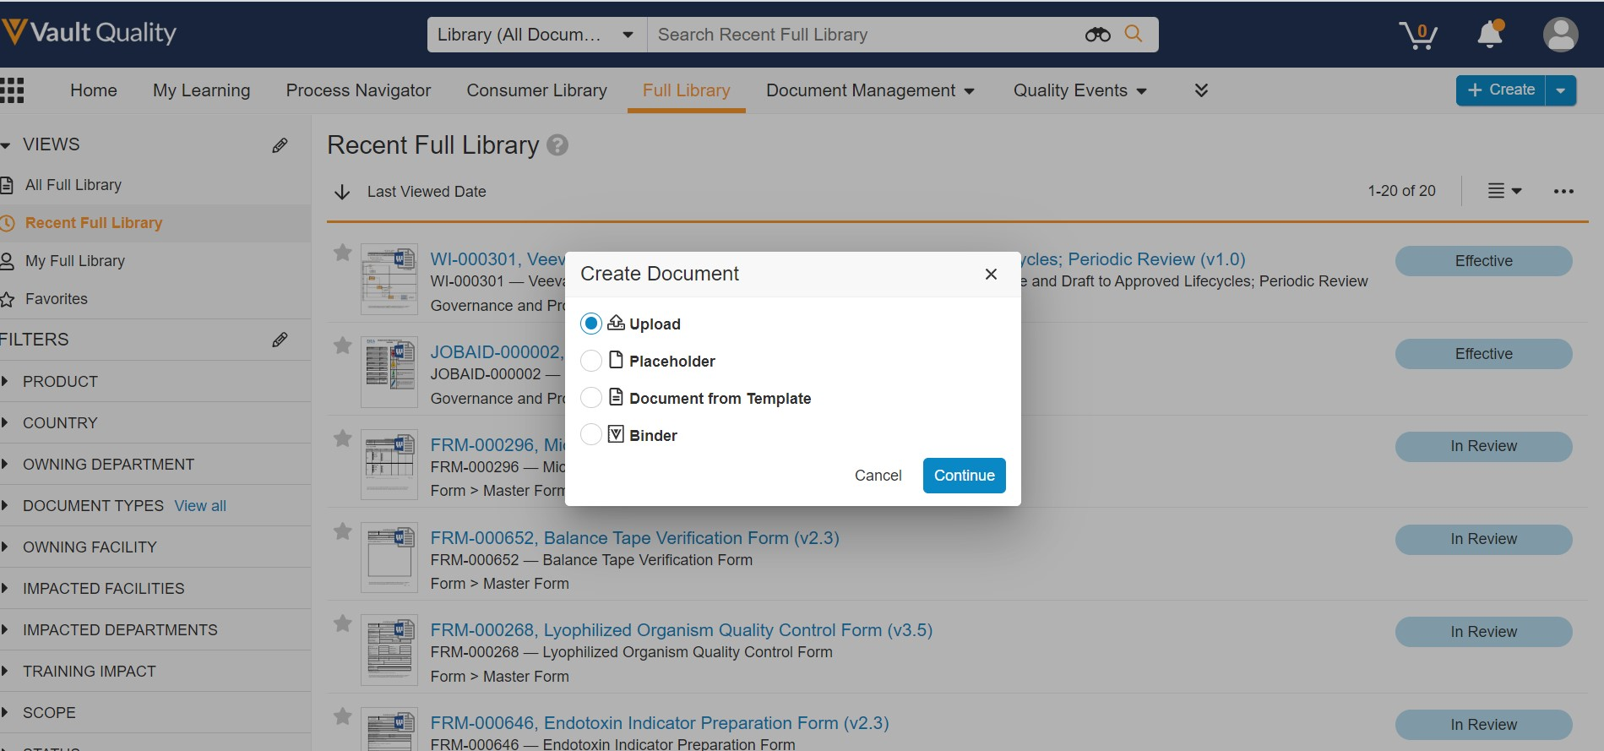

Slide 4
1. Draft to Approved
For this type of documents DCC (Document change control) is not required.

Slide 5
2. Draft to Effective
For this type of documents DCC (Document change control) is required.

Slide 6
DCC requirements for Draft to Effective docs
Description: Document name for easy identification
Reason: Justification is the reason
Type of change:
Administrative change (Like formatting changes)- IA not required
Major Revision: Will needs document change authorization and impact assessment
New Document: Will needs impact assessment.
Obsolete Document

Slide 7
Document Types
Draft to Approved
Annual Product Review (RPT)
Document Review (DOCREV)
Facility Maps (MAP)
Fillable Forms (FRM)
Protocols (PROT)
Master Training Plan (PLN)
Risk Assessments (ASSESS)
Sign (SIGN)
Summary Report (RPT)
Supporting Documents (SUP)
Occurrence (OCC)
Memorandums (MEMO)

Slide 8
Document Types
Draft to Effective
Master Form (FRM)
Master Batch Record (MBR)
Label (LBL)
Specification (SPEC)
Work Instruction (WI)
Template (TEMP)
Validation Master Plan (PLN)
Standard Operating Procedure (SOP)

Slide 9

Workflow – Draft to Approved
Upload the document and route it for collaborative authoring – Update the document number.
Route the document for Review – QA person must review the document.
Ready for approval – DCU will push for approvals
Approval – QA is the final approval
Approved

Slide 10
Workflow – Draft to Effective Docs
Upload the document and route it for collaborative authoring – Update the document number.
Route the document for Review – QA person must review the document
Ready for approval – DCU will push for approvals
Approvals will be at DCC
Once DCC Approved Document also Approved
Issued
Effective

Slide 11

Thank You

